Slide 1
Border regions : through the crisis together
15.01.2021

Slide 2
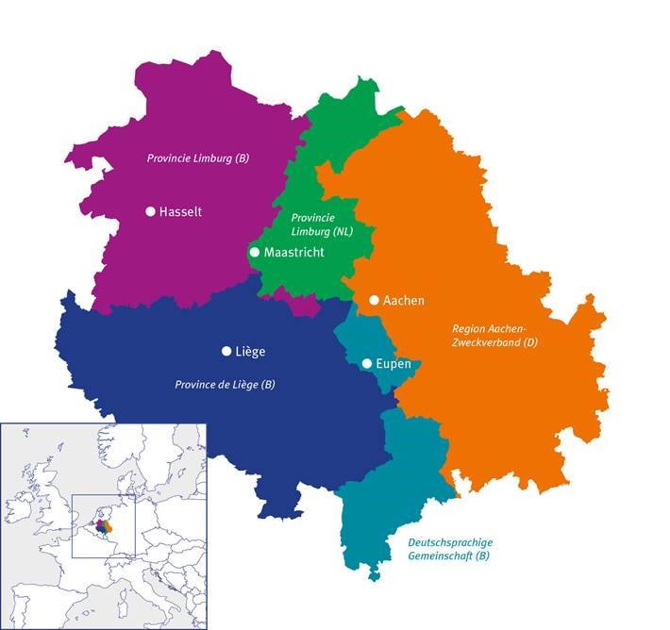
The Euregio Meuse-Rhine (EMR)
      3 countries (DE, BE, NL)
      5 partner regions
      4 Mio. inhabitants
      11.000 km²
      36.000 cb commuters
      > 5.000 in medical services

Slide 3
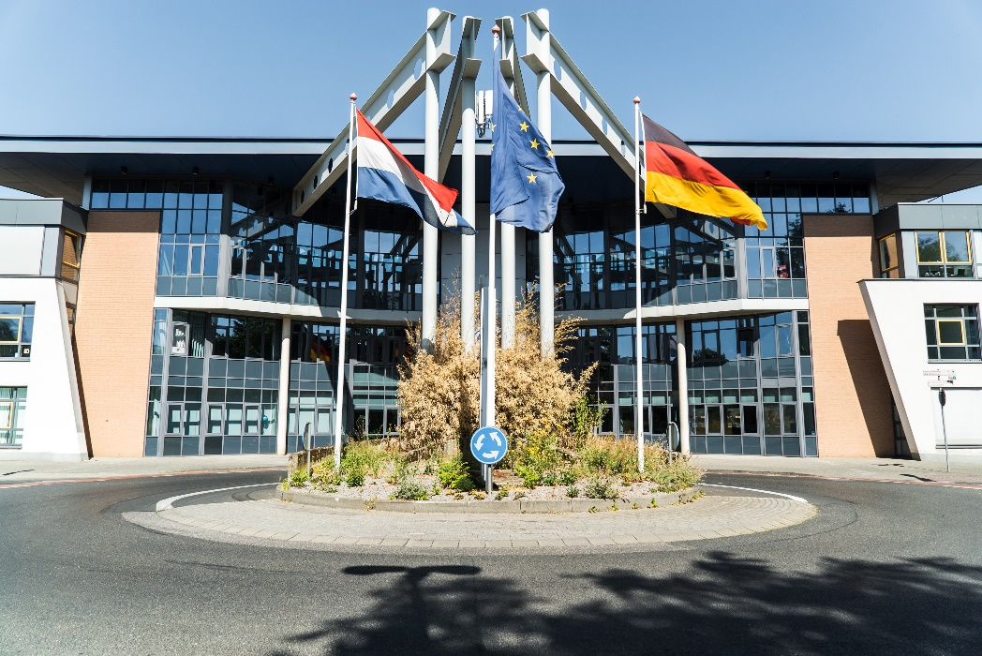
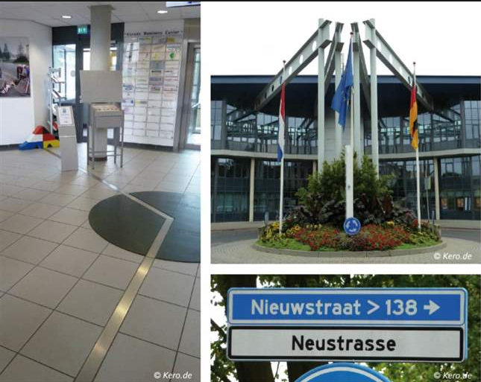
EMR: Borderless Region
Eurode Business Center

Slide 4
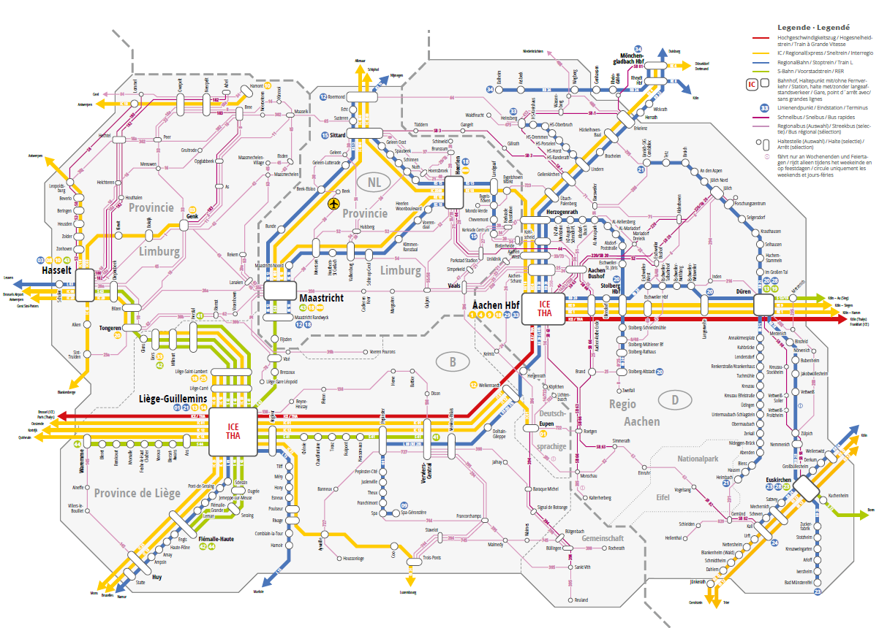
EMR: Connected border region
      …by public transport…

Slide 5








The Euregio Meuse-Rhine (EMR)
Finances
Education
Family
Hospital care
Tourism and culture
Medical care
Restaurant
Shopping

Slide 6
The Euregio Meuse-Rhine (EMR)
Finances
Education
Family
Hospital care
Tourism and culture
Medical care
Restaurant
Shopping

Slide 7




Cross border cooperation
      Answering citizens' questions
      Defend interests of people from the border region
      Resolve obstacles
      Inform national authorities
      Support crisis centers and partner regions

Slide 8



Cross border cooperation
      Answering citizens' questions
      When are people allowed to cross the border? Explaining the rules easily and service oriented…
> 500.000

Slide 9
Cross border cooperation
      Answering citizen’s questions
      When are people allowed to cross the border? Explaining the rules easily and service oriented…
> 500.000
Online form
https://crossing-borders.euregio-mr.info/en/

Slide 10
Cross border cooperation
      2. Defend interests of people from the border region
      Incompatible rules
      Reopening/keeping the borders OPEN
      The EGTC being the link between border information points, crisis centres and decision making!
      Putting their questions on the agenda every week, thanks to the trinational Cross-Border Task-Force Corona

Slide 11
Cross border cooperation
      Resolving border obstacles
      Forgotten cases?!
      People not foreseen in the national test strategies, because of their cross-border everyday life→ agreements to test on the other side of the border
      Unclear which documents to show at border control → creation of « laissez-passer » provided by municipalities

Slide 12
Cross border cooperation
      Inform national authorities
      EYES and EARS of the decision makers, when it comes to the situation at borders. Permanent reporting:
Problems of cb workers
Movements and general SITEREP
Overview and comparison of the measures taken at national level

Slide 13
Cross border cooperation
      5. Support crisis centers and partner regions
      - Daily and permanent cooperation between crisis centers!
      - EGTC as link between field and policy
      So far:
      Millions of masks organized and brought through cb partners
      Thousands of PCR-tests and their analyses done through cb partners
      Patients from BE and NL taken care of in DE

Slide 14

And Europe?
      CRII+ and Interreg: the right tool at the right moment…
        → PandEMRIC: 1.7 Mio€ to support our cb crisis management.
        (Implement the lessons learned during the first wave)
      Questions asked in EP by our MePs, Pressure by the Commission to reopen the borders, etc.

Slide 15
New possibilities for CBC?
        Recognition of the existing European integration in border regions
        Role of the cb governance structures (Euregios, GROS, etc.)
        Added-value of preparation in „normal times“ → operational structural cooperation needed
        Opportunities through CBC → PCR-tests, IC beds, masks etc. obtained in/through the neighbouring countries
        Added-value of fast and flexible rules of Interreg
        Call for „counciliation“ through cultural activities
        → Problem: communication!!!!

Slide 16
      In the end we only regret the chances
      we didn’t take!
      - Lewis Carroll
Contact:
info@euregio-mr.eu
www.euregio-mr.eu

